Slide 1
CIS 4930-001: Introduction to Augmented and Virtual Reality
Scene Graph and Acceleration Strategies

Slide 2
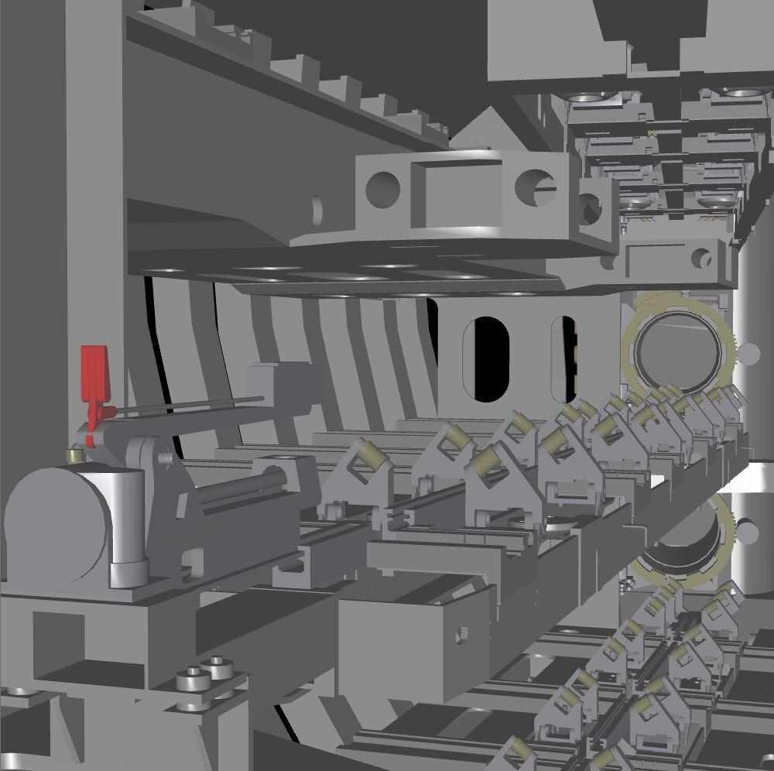
Motivation
VR scenes need complexity
Immersion
People don’t bother with VR for easy problems
lots of geometry
How do we organize objects?
How do we maintain speed?
Wait for the graphics cards?

Slide 3
Limitations of Immediate Mode Graphics
When we define a geometric object in an application
Object is passed through the pipeline
To redraw the object, either changed or the same, we must re-execute the code
At the end of the day, we manage objects directly

Slide 4
The Scene Graph
Build a structure that allows:
More intuitive/organized modeling
Global analysis of the model
To generate OpenGL calls in an efficient way
CPU-level preprocessing to avoid overloading graphics pipeline
Object culling

Slide 5
Scene Graphs
Thinking objects … not vertices
Scene Graph: Directed Acyclic Graph (DAG)
Represents object-based hierarchy of geometry
Suits a bottom-up design of objects & scenes
Common for most graphic API’s
Thinking content … not rendering process
A scene is a collection of nodes
Nodes are: groups, lights, geometry, transforms, sounds, rendering states, etc…
Nodes hold pointers to children
Provides the hierarchical framework for grouping objects together, spatially
Behavior can be built into the scene-graph: collision detection, animations, …
Abstracts the hardware (i.e. multipass/multitexture)
Possible to optimize the rendering
Sorting of: material state changes; polygons when rendering transparency; etc.

Slide 6
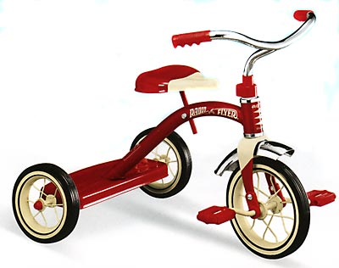
Examples Scene Graph
tricycle
T
T
Seat
Front Group
Back wheels
Handle bars
Left wheel
Right wheel
T
Front Wheel

Slide 7
Example of some scene-graph elements
Group Nodes
Collects a number of nodes in a logical way
Level of Detail, Switch nodes
Transformation Nodes
Moves, rotates, scales its children/siblings
Light Nodes
Point light, Spotlight, Directional, ...
Geometry Nodes
Usually a leaf node
Polygons, lines, points, ...
Material
Others
Sound, fog, manipulators (animators), Collision, ...
Visitor/Traversers
Walks through the scene graph and operate on each node
RenderVisitor, CullVisitor,…

Slide 8
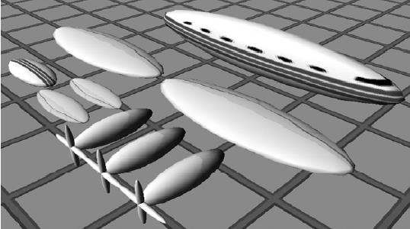
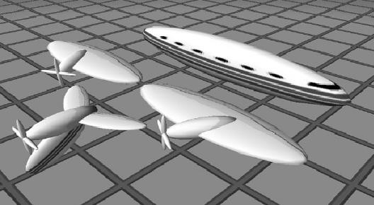
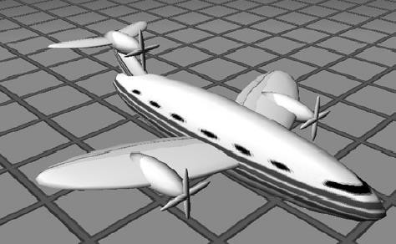
An example
Scene graph items
Scene graph groups
Final Scene

Slide 9
Benefits
Transparent use of underlying hardware
Possibly for the scene graph to optimize the rendering of the content
State sorting (render objects with same shaders, textures, etc. together)
Rendering order of transparent objects
Sharing of data
Objects with the same appearance can share state
Objects with the same geometry can share geometry (smaller memory footprint)
Possible to serialize (and to store or send over the internet)
Rendering Acceleration!

Slide 10
Acceleration algorithms
Never enough horse power
Four performance goals
Higher FPS
Higher Resolution
More realism
Lower power
We will always need to assist the hardware with clever data structures and algorithms

Slide 11
Spatial Data Structures
Organize data in some n-dimensional space
We want to accelerate queries such as
Does the following geometry overlap any other geometry?
Does this ray intersect anything in the scene?
Using a tree structure
Construction of a tree can be expensive and should in some cases be done as a preprocess
Speedups for queries and traversals from O(n) to O(log n)
Three flavors:
Binary Space Partition trees (BSP)
Quadtrees/Octrees/Kd-trees
Bounding Volume Hierarchies (BVH)

Slide 12
Quadtrees/Octrees
Recursively divide space in 2D (quadtrees) or 3D (octrees)
At each tree level objects get placed in the quadrant or octant that is “most appropriate”.

Slide 13
KD-Trees
Recursively divide space in 2 parts by selecting the dimension and cut that best divides the objects
At each level objects get placed in the “most appropriate” division.

Slide 14
Binary Space Partition (BSP)
Similar to kd-tree except cuts no longer need to be axis aligned

Slide 15
Bounding volumes
We want a simpler representation of a geometry
Not for rendering, but for intersection/collision tests
Specs:
Should fit enclosed geometry as tight as possible
Should be simple to use in collision test
Specs are contradictory

Slide 16
Bounding volume geometry
Bounding spheres
+ Simple to create
+ Simple collision detection
- Could potentially be a bad choice for long thin objects
Axis Aligned Bounding Box (AABB)
+ Simple to create
+ Simple collision detection
- A lot of empty space enclosed
Oriented Bounding Box (OBB)
+ Less empty space enclosed
- More complicated to create
- More complicated during collision detection
k-Dop (discrete oriented polytope)
+ Least empty space
- Most complicated to calculate
Y
(BS)
X
Y
(AABB)
X
Y
(OBB)
X
Y
(k-Dop)

Slide 17
Bounding volume geometry
Less empty space – more complex to create and use
Collision calc. complexity
1/surrounding
volume

Slide 18
“The fastest rendered polygon, is the one never sent down the rendering pipeline”
Real-Time Rendering Akenine-Möller, Haines, and Hoffman

Slide 19
Speeding the graphics pipeline
What are some ways the graphics pipeline speeds rendering?
Off-screen geometry: solved by clipping
Occluded geometry: solved by Z-buffer
Clipping/Z-buffering take time linear to the number of primitives/fragments
How can Scene Graphs help?
Off-screen: view-frustum culling, portal culling, contribution culling
Occluded by other objects: occlusion culling, backface culling
All work on the object level, instead of the primitive level

Slide 20
Culling
View frustum culling
Small feature culling
Back-face culling
Occlusion culling
View Frustum
Rendered (visible)
Not rendered (in-visible)
Portal culling

Slide 21
View Frustum Culling Goal
Quickly eliminate large portions of the scene which will not be visible in the final image
Not the exact visibility solution, but a quick-and-dirty conservative estimate of which primitives might be visible
Z-buffer & clipping this for the exact solution
This conservative estimate is called the potentially visible set or PVS

Slide 22
View frustum culling
Remove object not inside view frustum (VF)
Complete test is called exclusion/inclusion/intersection test
Exclusion a BV is completely outside the VF, thus not rendered
Inclusion the BV is completely inside the VF, thus rendered
Intersection, part of the BV is inside, part is outside. Here we have a few options.

Slide 23
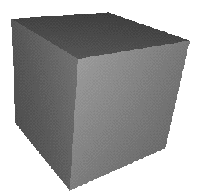
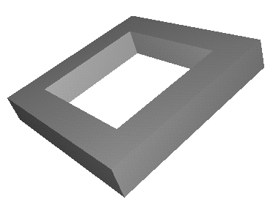
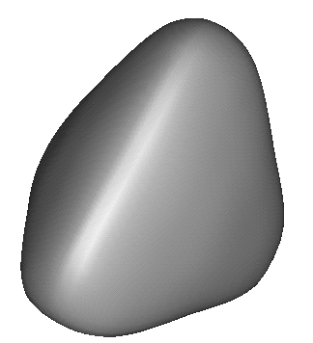
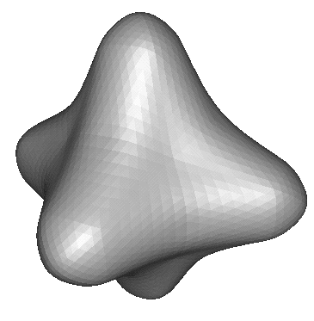
Scene graph example
scene graph
circles=BVs
root
Notes:
Objects close to each other in the virtual world are close in the scene graph

Slide 24
Example of Hierarchical View Frustum Culling
root
camera
Notes:
Assuming that testing a sphere against the view frustum is cheaper than rendering the object

Slide 25
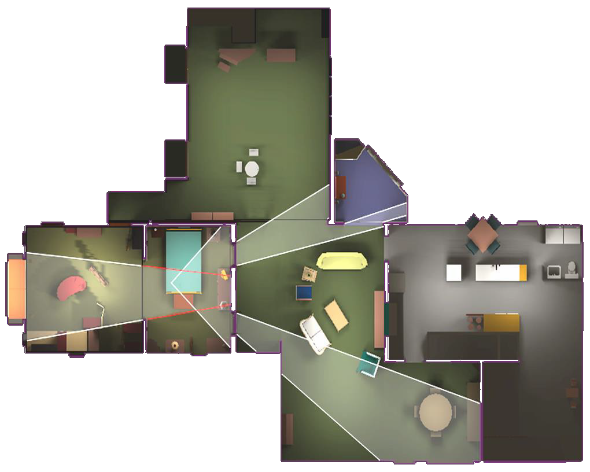
Portal Culling
Goal: walk through architectural models (buildings, cities, catacombs)
Divide scene into cells
Room, hallways
Each object (furniture etc.) associated to a cell are referenced
Define portals
Door/windows connect adjacent rooms
For each cell associate portals to that cell
Create an adjacency graph of cells
Each cell connect to other cells through portals.
Extension of VF culling
The VF is adjusted to the adjacent portals
Notice: cells only see other cells through portals

Slide 26
Cells & Portals
Starting with cell containing eye-point, traverse graph, rendering visible cells using original View Frustum (VF)
For each Portal visible in VF
Reduce VF to fit Portal
Now render Cell with reduced VF
For each portal visible in VF… (recursion)
A cell is only visible if it can be seen through a sequence of portals
So cell visibility reduces to testing portal sequences for a line of sight…

Slide 27

Cells & Portals
A
E
D
B C
F
G
H
A
E
B
C
D
F
G
H

Slide 28
Cells & Portals
A
E
X F
D
B C
G
H
A
E
B
C
D
X
F
G
H

Slide 29
Contribution Culling
Idea: objects whose projected bounding volume occupy less than N pixels are culled
This is an approximative algorithm as the things you cull away may actually contribute to the final image
Advantage: trade-off quality/speed
Notes:
Also, called SCREEN-SIZE CULLING
Bullet 2: This implies that this is an approximation….forts slide
Bullet 3: higher speed if larger threshold (N)
Often combined with Hierarchical VF CULL,
that is, DONE in a hierarchical fashion as well

Slide 30
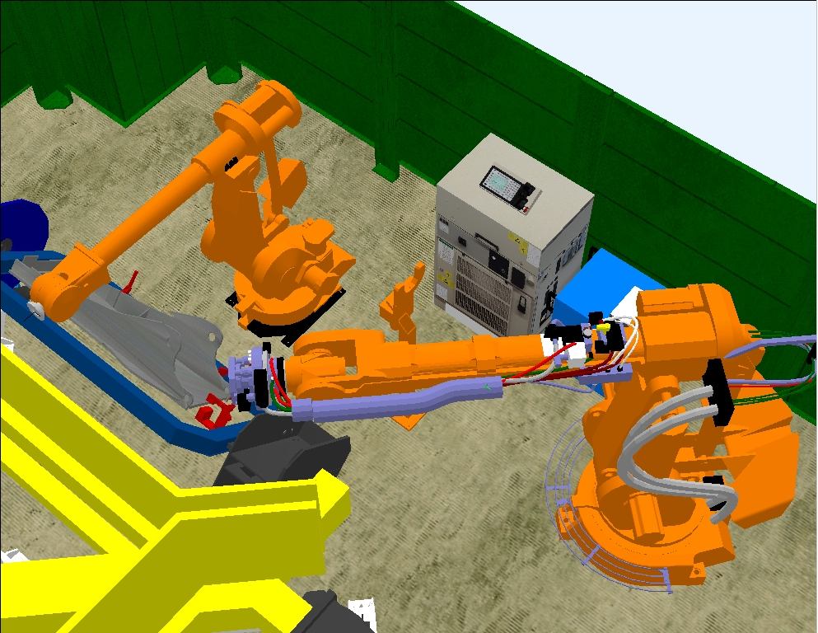

Example of Contribution Culling
Not much visual difference, but 80-400% faster
Particularly effective when moving
contribution culling OFF
contribution culling ON
Images courtesy of ABB Robotics Products, created by Ulf Assarsson

Slide 31
Occlusion Culling
Main idea: Objects that lies completely “behind” another set of objects can be culled
Hard problem to solve efficiently
Notes:
There are many algorithms for occlusion culling (two new papers at SIGGRAPH from MIT).
I believe that different algorithms should be used for different environments,
so for example: very different circumstances indoors/outdoors/forest/etc

Slide 32
Backface culling
If normal of a surface is pointing away from viewer, remove it
Works for closed object where we don’t want to see the inside of the object (for example a sphere)
Does not work well with for terrain (most polygons visible)
v
n

Slide 33
Simplify Geometry
One polygon
Sprites
Billboards
Impostors
Many polygons
Level of detail (LOD)

Slide 34
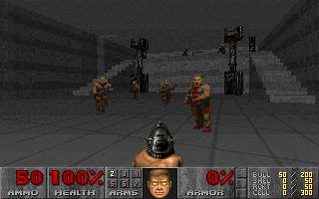

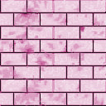


Old School: Sprites
A rectangular shaped image that moves around on the screen
One-to-one mapping with pixels on the screen
The earliest PC graphics were sprite
Implementation
An image texture on a polygon with the use of alpha channel
+
=
background
sprite image
result

Slide 35
Billboarding
Textured polygon
Combined with alpha texturing, bump mapping, and (potentially) animation
ex. smoke, fire, explosions, vapor trails, clouds

Slide 36
Axial Billboard
Billboards at fixed location rotates to face user
Useful for representing objects with cylindrical symmetry
displaying trees

Slide 37
Multi-Polygon Billboards
Use two polygons at right angles
No alignment with viewer
Use more polygons for better appearance

Slide 38
Impostors
Replace 3D geometry with a 2D image
2D image fools viewer into thinking 3D geometry is still there
Big limitation: No parallax

Slide 39
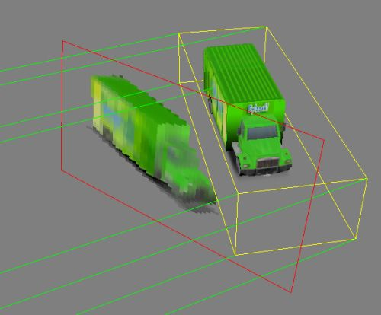
Impostors Technique
Basic idea
Render set of geometry into a large texture: an impostor
Now render impostor texture instead of the geometry
Only helpful when impostors can be reused across many frames

Slide 40
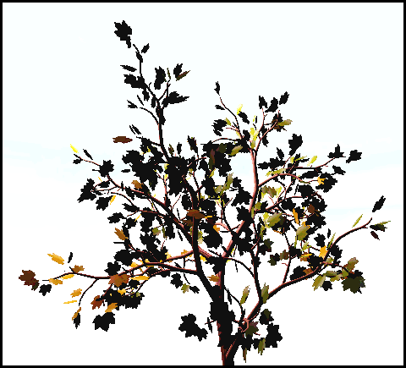
Impostors: Example
We render a set of geometry into an impostor (image/texture)

Slide 41
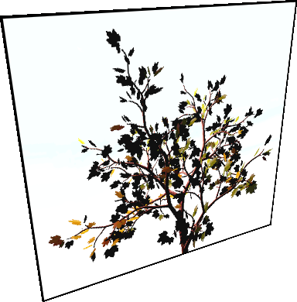
Impostors: Example
We can re-use this impostor in 3D for several frames

Slide 42
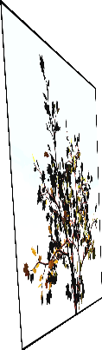
Impostors: Example
Eventually, we have to update the impostor

Slide 43
Level of Detail
The problem:
Geometric datasets can be too complex to render at interactive rates
One solution:
Simplify the polygonal geometry of small or distant objects
Known as Level of Detail or LOD
A.k.a. polygonal simplification, geometric simplification, mesh reduction, decimation, multiresolution modeling, …
Focuses on the fidelity / performance tradeoff

Slide 44
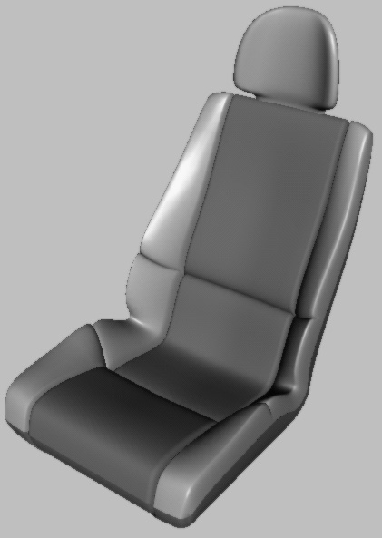
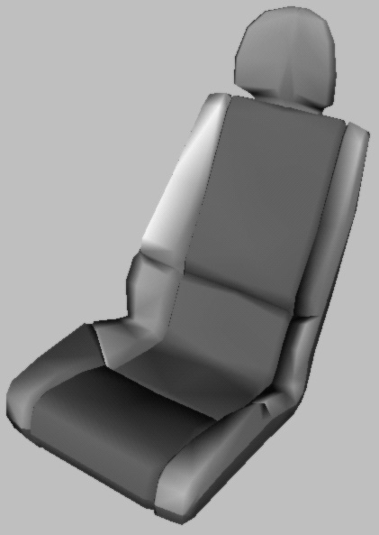
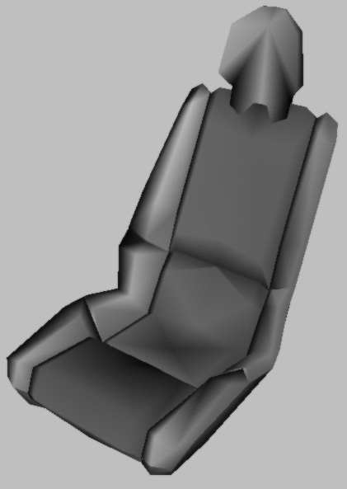
Level-of-Detail Rendering
Use different levels of detail at different distances from the viewer
More triangles closer to the viewer
Notes:
IDEA: Does not make sense to use 10,000 triangles when the object cover 50 pixels on-screen
Different levels of detail == different number of polygons
BECAUSE, when an object is far away,

Slide 45
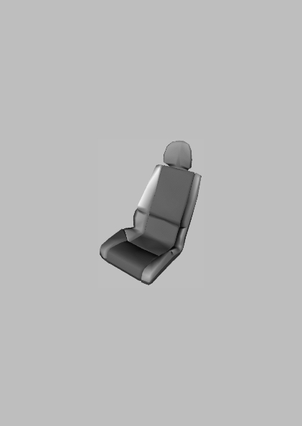

LOD rendering
Use area of projection of BV to select appropriate LOD
Not much visual difference, but a lot faster
Notes:
Other criteria to select LOD: distance to the object, rendering budget (I.e., do we have time to draw a more complex LOD?)
Many different types of LODs : what we’ve shown here are called “Discrete Geometry LODs”
Read more in the book about Alpha LODs, Geomorph LODS, and more sophisticated LOD
selection critera.
Speedups: usually at least a factor of 2

Slide 46
Scene graph with LODs
Car chair

Slide 47
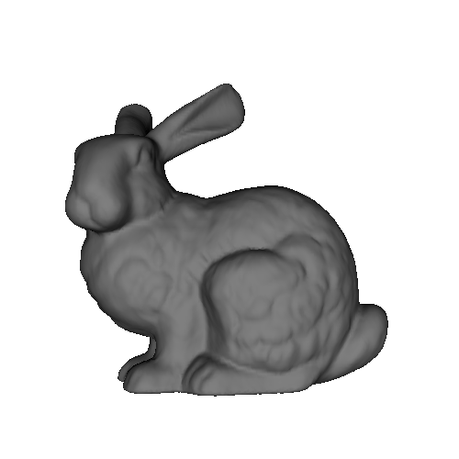

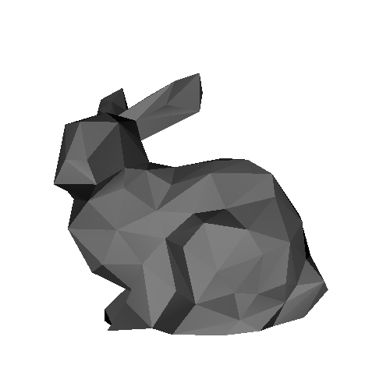
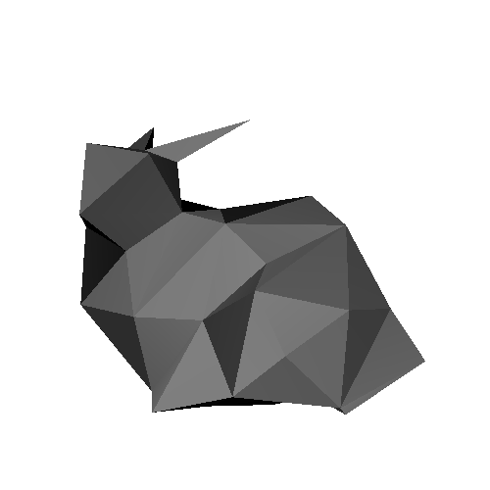
Another Example
69,451 polys
2,502 polys
251 polys
76 polys
Courtesy Stanford 3D Scanning Repository

Slide 48
Another Example
Courtesy Stanford 3D Scanning Repository

Slide 49
Level of Detail: The Big Questions
How to generate simpler versions of a complex model?
How to evaluate the fidelity of the simplified models?
When to use which LOD of an object?
69,451 polys
2,502 polys
251 polys
76 polys
Courtesy Stanford 3D Scanning Repository

Slide 50
Discrete LOD Approach
Traditional LOD in a nutshell:
Create LODs for each object separately in a preprocess
At run-time, pick each object’s LOD according to the object’s distance (or similar criterion)
Since LODs are created at fixed resolutions, we call this discrete LOD

Slide 51
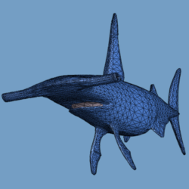
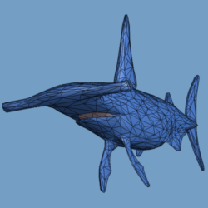
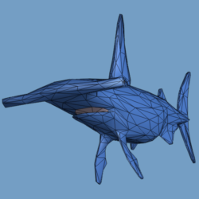
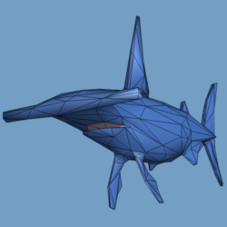
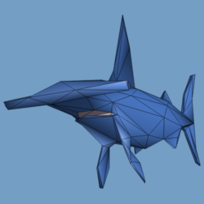
Discrete Level-of-detail (LOD)
distance
from viewer?
close
far
10,000
2,000
1,000
500
250
[Clark76, Funkhouser93]
Notes:
These simplified meshes are often used in the context of level-of-detail.
The idea is to use a fully-detailed mesh when the model is close to the viewer, and to substitute coarser and coarser approximations as the object recedes away from the viewer.
<click> One concern with this approach is that instantaneous switching between the various meshes may result in a “popping” perceptible to the user.
Therefore we would like to have a smoother level-of-detail representation.

Slide 52
Discrete LOD: Advantages
Simple programming model—decouples simplification and rendering
LOD creation need not address real-time rendering constraints
Run-time rendering need only pick LODs

Slide 53
Level 0
Level 1
Level 2
Choosing the LOD
Heuristic Approach
Assign each LOD a range of distances
Calculate distance from viewer to object
Use corresponding LOD
Problems:
Visual “pop” when switching LODs can be disconcerting
Doesn’t maintain constant frame rate
Requires someone to assign switching distances by hand
Correct switching distance may vary with field of view, resolution, etc.

Slide 54
Level 0
Level 1
Level 2
Choosing the LOD
Adaptively maintaining frame rate
Scale LOD switching distances by a “bias”
If last frame took too long, decrease bias
If last frame took too little time, increase bias
Problems:
Oscillation caused by overly aggressive feedback
Sudden change in rendering load can still cause overly long frame times

Slide 55
Choosing the LOD
Predictively maintaining frame rate
For each LOD estimate:
Cost (rendering time)
# of polygons
Vertex & fragment processing load
Benefit (importance to the image)
Size: larger objects contribute more to image
Accuracy: # of verts/polys, shading model, etc.
Priority: account for inherent importance
Eccentricity: peripheral objects harder to see
Velocity: fast-moving objects harder to see
Hysteresis: avoid flicker; use previous frame state
Given a fixed time budget, select LODs to maximize benefit within a cost constraint [Funkhouser & Sequin, SIGGRAPH 93]
Sort objects by benefit/cost ratio, pick in sorted order until budget is exceeded

Slide 56
Continuous Level of Detail
Create data structure from which a desired level of detail can be extracted at run time.

Slide 57
New mesh simplification procedure
Apply sequence of edge collapses
edgeCollapse(v_{s} ,v_{t} , v_{st} )
v_{t}
v_{l}
v_{r}
v_{l}
v_{st}
v_{r}
v_{s}
(optimization)
Notes:
I’ll now introduce our new simplification procedure.
Conceptually it’s extremely simple.
It simplifies the original mesh by applying to it a sequence of edge collapse transformations.
As shown here, an edge collapse is a local mesh operation that takes two adjacent vertices of the mesh and unifies them into one, removing two faces in the process.
Note that the position of the new unified vertex can be arbitrary.
<click> Of course, there is an optimization procedure for selecting which edges to collapse and what geometry to assign to the new vertices, and I’ll return to that issue a little later.
<click><35mm> (copy slide)

Slide 58
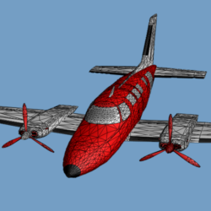
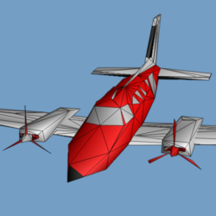
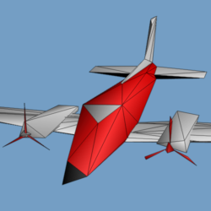
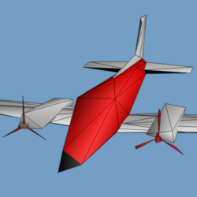
Simplification process (also invertible)
13,546
500
152
150
M’=
M_{n}
M_{j}
M₁
M₀
ecol_{n-1}
ecol_{i}
ecol₀
Notes:
Thus the simplification starts with the original mesh, denoted M^n, and through a sequence of edge collapse transformations, simplifies it down to a very coarse base mesh, M^0.
<click> You can see the effect of the very last edge collapse transforming M^1 into M^0; it removes the last window from the airplane.

Slide 59
Continuous LOD: Advantages
Better granularity == better fidelity
LOD is specified exactly, not chosen from a few pre-created options
Thus objects use no more polygons than necessary, which frees up polygons for other objects
Net result: better resource utilization, leading to better overall fidelity/polygon
Better granularity == smoother transitions
Switching between traditional LODs can introduce visual “popping” effect
Continuous LOD can adjust detail gradually and incrementally, reducing visual pops
Can even geomorph the fine-grained simplification operations over several frames to eliminate pops [Hoppe 96, 98]
Naturally leads to view-dependent LOD

Slide 60
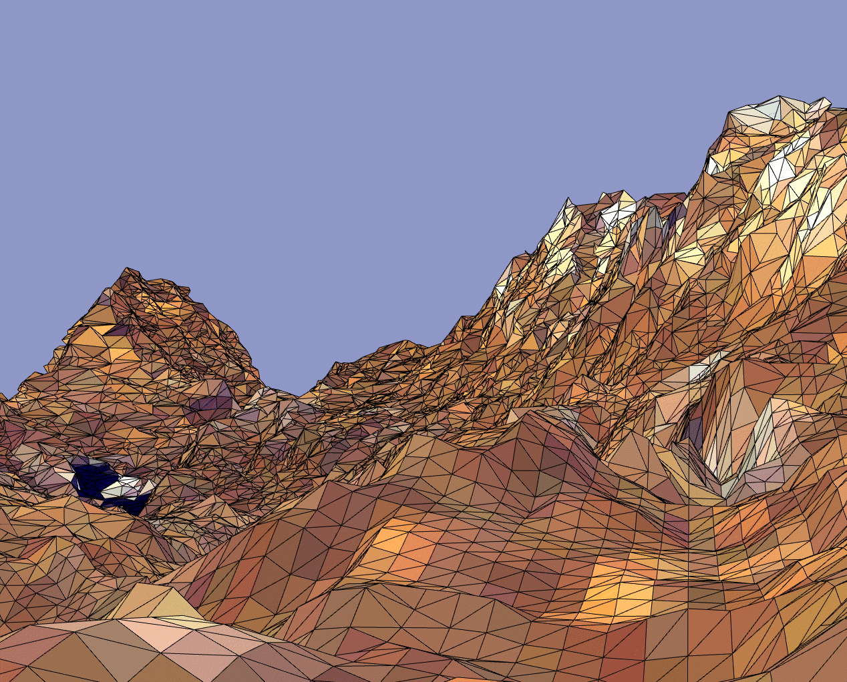
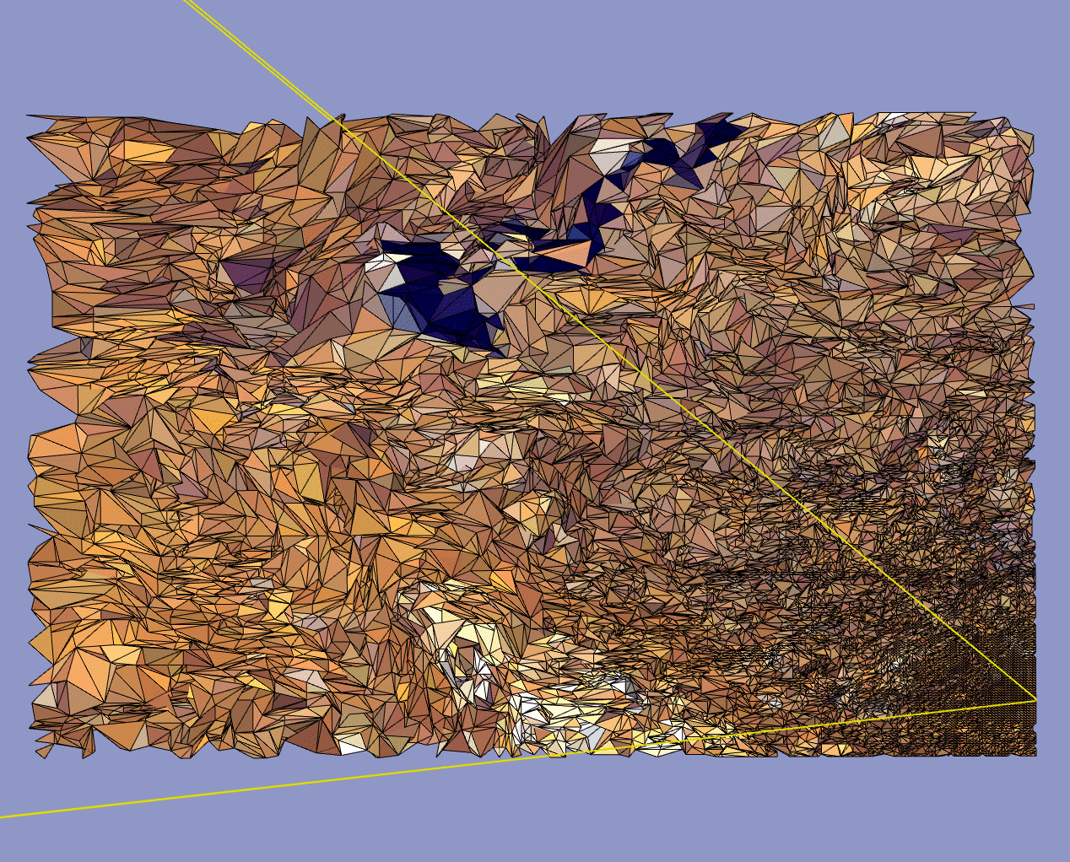
View-Dependent LOD: Examples
Use current view parameters to select best representation for the current view
Show nearby portions of object at higher resolution than distant portions
View from eyepoint
Birds-eye view

Slide 61
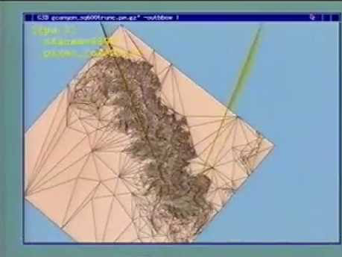
Demo Video
https://youtu.be/JBvyqu_wFeE

Slide 62
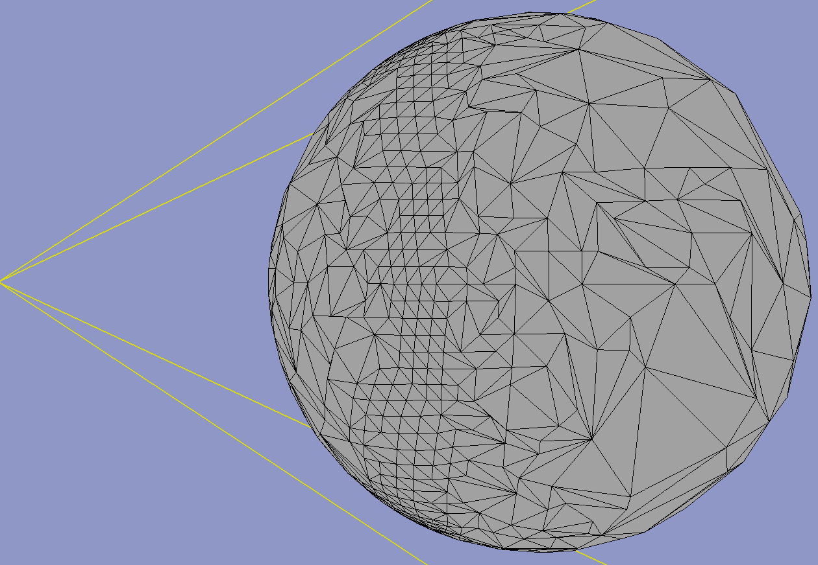
View-Dependent LOD: Examples
Show silhouette regions of object at higher resolution than interior regions

Slide 63
View-Dependent LOD
Advantages
Enables drastic simplification of very large objects
Better granularity
Allocates polygons where they are most needed
Enables even better overall fidelity
Disadvantages
More complicated object data structures
More expensive LOD selection

